Slide 1
Software Quality Engineering
Lecture 2
software testing
Alina Arshad
alina.arshad@nu.edu.pk

Slide 2
A Good Software Tester
Find bugs as early as possible and make sure they get fixed.
To understand the application well.
Study the functionality in detail to find where the bugs are likely to occur.
Study the code to ensure that every line of code is tested.
Create test cases in such a way that testing is done to uncover the hidden bugs and also ensure that the software is usable and reliable.

Slide 3
Guidelines for testing
Testing a system’s capabilities is more important than testing its components.
Testing old capabilities is more important than testing new capabilities.
Testing typical situations is more important than testing boundary value cases.
Do it in a simple manner.
Have a good foresight.
Think comprehensively.
Good reasoning abilities.

Slide 4
Software Testing Principles
Everything should be planned so is testing. It should be based on certain principles. These principles are as follows:
Testing must be traceable to the requirements.
Testing should be planned for early in a software process.
Testing should be incremental.
Testing should focus on exceptions.
Debugging should be planned for separately so that there is enough time and budget to understand and resolve bugs.

Slide 5
Software testing strategies
Two basic testing strategies:
To test the software in its entirety, once the completed package is available; otherwise known as “big bang testing”.
To test the software piecemeal, in modules, as they are completed (unit tests); then to test groups of tested modules integrated with newly completed modules (integration tests). This process continues until all the package modules have been tested. Once this phase is completed, the entire package is tested as a whole (system test). This testing strategy is usually termed “incremental testing”.

Slide 6

Point to Ponder
Although testing detects errors, alone it cannot be used to build quality. Why so?
Quality has to be built into the software by using good software
engineering practices such as reviews, walk through and inspection during analysis, design, and coding.

Slide 7
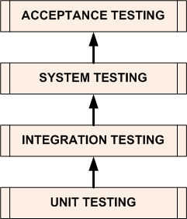
Software Testing Levels

Slide 8
Testing the System (I)
Unit Tests
Tests that cover low-level aspects of a system
For each module, does each operation perform as expected
Integration Tests
Tests that check that modules work together in combination
Most projects on schedule until they hit this point
All sorts of hidden assumptions are surfaced when code written by different developers are used in tandem.

Slide 9
Testing the System (II)
System Tests
Tests performed by the developer to ensure that all major functionality has been implemented
Acceptance Tests
Tests performed by the user to check that the delivered system meets their needs

Slide 10
Static and Dynamic Testing
Static testing refers to testing activities without executing the source code. All verification activities like inspections, walkthroughs, reviews, etc. come under this category of testing.
Dynamic testing refers to executing the source code and seeing how it performs with specific inputs. All validation activities come in this category where execution of the program is essential.

Slide 11
Limitations of testing
Test everything before giving the software to the customers.
‘EVERYTHING’
Execute every true and false condition
Execute every statement of the program
Execute every condition of a decision node
Execute every possible path
Execute the program with all valid inputs
Execute the program with all invalid inputs
impossible to achieve due to time and resource constraints
Notes:
is very illusive and has many meanings. What do we understand when we say ‘everything’? We
may expect one, two or all of the following when we refer to ‘everything’:

Slide 12
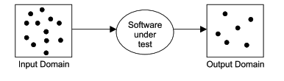
Functional Testing
Main intent of software testing is to search of such test cases which may make the software fail.
Functional testing techniques attempt to design those test cases which have a higher probability of making a software fail.
These techniques also attempt to test every possible functionality of the software.
Notes:
Observed output(s) is (are) compared with expected output(s) for selected input(s) with preconditions, if any. The software is treated as a black box.
This black box knowledge is sufficient to design a good number of test cases. Many activities are performed in real life with only black box knowledge like

Slide 13
Functional Testing
In functional testing techniques, execution of a program is essential and hence these testing techniques come under the category of ‘validation’.
These techniques can be used at all levels of software testing like unit, integration, system and acceptance testing.
Notes:
driving a car, using a cell phone, operating a computer, etc

Slide 14
BOUNDARY VALUE ANALYSIS
Popular functional testing technique that concentrate on input values and design test cases with input values that are on or close to boundary values.
Write a program ‘Square’ which takes ‘x’ as an input and prints the square of ‘x’ as output. The range of ‘x’ is from 1 to 100.
How to test this program???
One possibility is to give all values from 1 to 100 one by one to the program and see the observed behavior.
In boundary value analysis, we select values on or close to boundaries and all input values may have one of the following:
Just above minimum value
Minimum value
Maximum value
Just below maximum value
Nominal (Average) value

Slide 15
Applicability
This technique is suited to programs in which input values are within ranges or within sets and input values boundaries can be identified from the requirements.
This is equally applicable at the unit, integration, system and acceptance test levels.
Notes:
can significantly reduce the number of test cases and

Slide 16
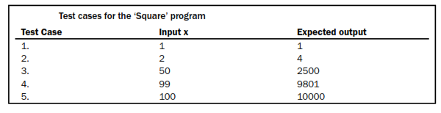

Boundary value analysis for square program
The number of inputs selected by this technique is 4n + 1 where ‘n’ is the number of inputs.
Notes:
Activity : take another example

Slide 17
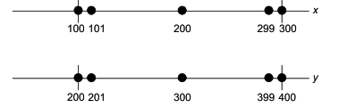
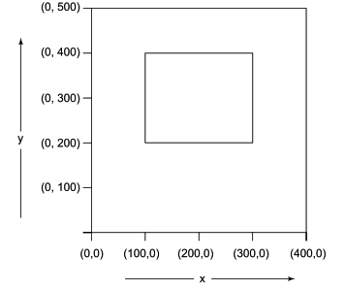
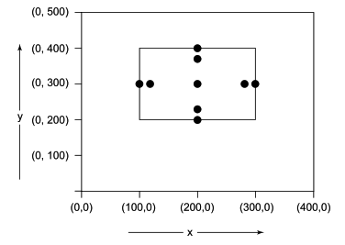
Another example
Consider a program ‘Addition’ with two input values x and y and it gives the addition of x and y as an output. The range of both input values are given as:
100<= x <= 300
200 <= y <= 400

Slide 18
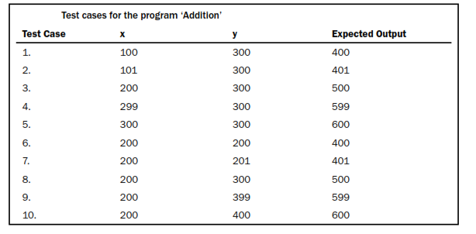

Slide 19
EQUIVALENCE CLASS TESTING
A large number of test cases are generated for any program. It is neither feasible nor desirable to execute all such test cases.
We may divide input domain into various categories with some relationship and expect that every test case from a category exhibits the same behavior.
If categories are well selected, we may assume that if one representative test case works correctly, others may also give the same results.
Each category is called an equivalence class and this type of testing is known as equivalence class testing.
Notes:
Many test cases do not test any new thing and they just execute the same lines of source code again and again.

Slide 20
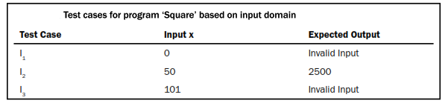

Creation of Equivalence Classes
The entire input domain can be divided into at least two equivalence classes: one containing all valid inputs and the other containing all invalid inputs.
Each equivalence class can further be sub-divided into equivalence classes on which the program is required to behave differently.
Square program

Slide 21
Any question????

